Slide 1
Augmented Reality
HCDE 525
Abhay Sawhney

Slide 2
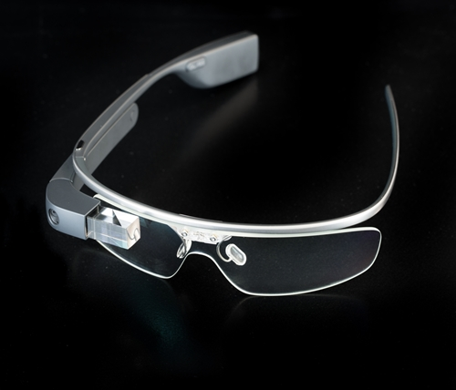
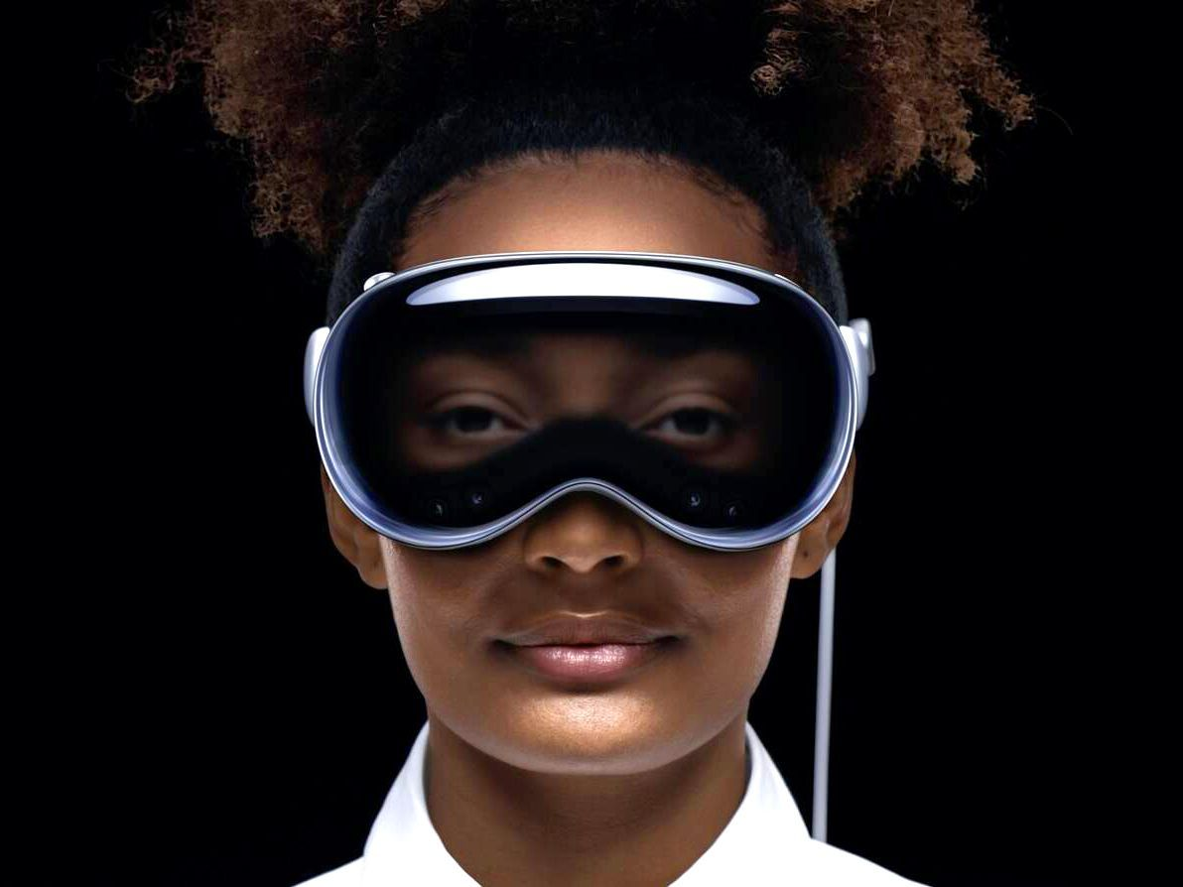
Timeline
2013 – Google Glass: First smart glasses; failed due to privacy/usability.
2015 – HoloLens: Enterprise-focused, hands-free holographic display.
2018 – Magic Leap One: Lightfield display, dev-focused.
2019 – HoloLens 2: Wider view, better hand tracking.
2024 – Apple Vision Pro: High-res, mixed reality headset.
Notes:
2013 – Google Glass: Google launches the Glass Explorer Edition for $1,500, pioneering smart glasses with a mini display overlaying information in the wearer’s viewortmoragency.comortmoragency.com. It sparked huge interest but faced public pushback over privacy and was shelved in 2015.
2015 – Microsoft HoloLens: Microsoft unveils HoloLens, the first standalone holographic AR headset, featuring advanced sensors and optics to blend 3D “holograms” with the real worldnext.reality.news. Aimed initially at developers/enterprise, HoloLens set a new bar for immersive AR.
2018 – Magic Leap One: After years of secrecy and investment, Magic Leap ships the One Creator Edition AR headset. It uses a lightfield display with goggles tethered to a hip-worn computer, offering a wider field of view than HoloLens and targeting creative developersnext.reality.newsnext.reality.news.
2019 – HoloLens 2: Microsoft releases HoloLens 2 with a significantly larger field of view, improved hand tracking, and a lighter, more ergonomic designnext.reality.news. It remains one of the most advanced AR headsets for enterprise use, deployed in manufacturing, healthcare, and military projects.
2023 – Apple Vision Pro: Apple announces its first spatial computing headset, Vision Pro, blending AR and VR (mixed reality). Shipping in 2024 for $3,499, it boasts dual 4K+ micro-OLED displays, eye/hand tracking, and a new visionOS operating systemen.wikipedia.orgen.wikipedia.org. Apple’s entry underscores that AR/MR is becoming mainstream in the next generation of consumer devices.

Slide 3
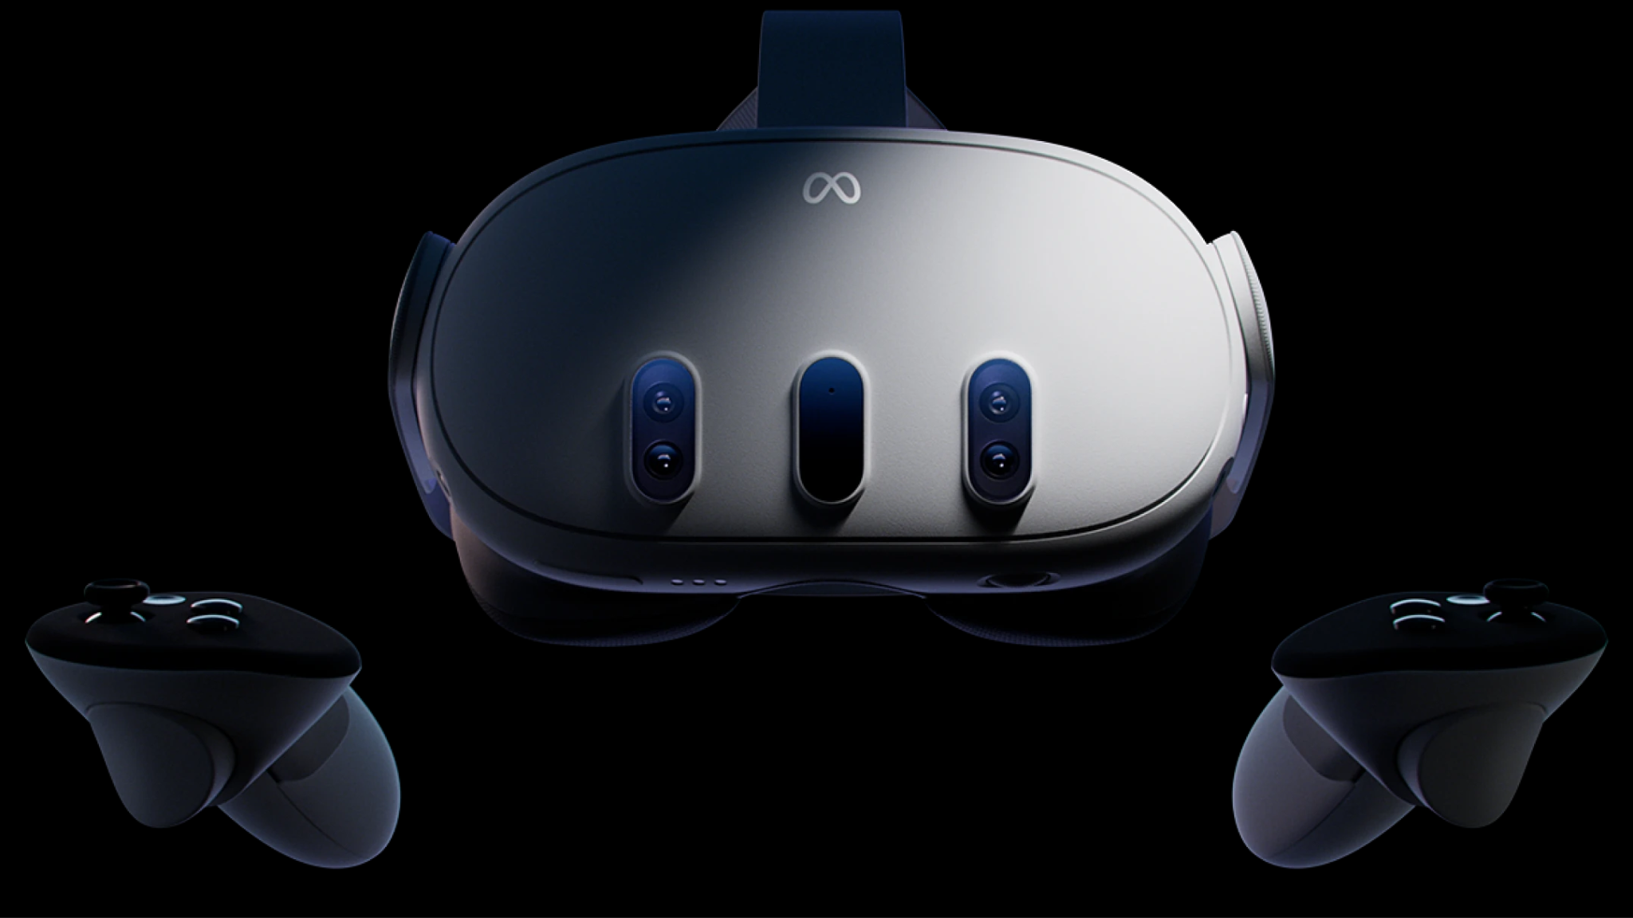
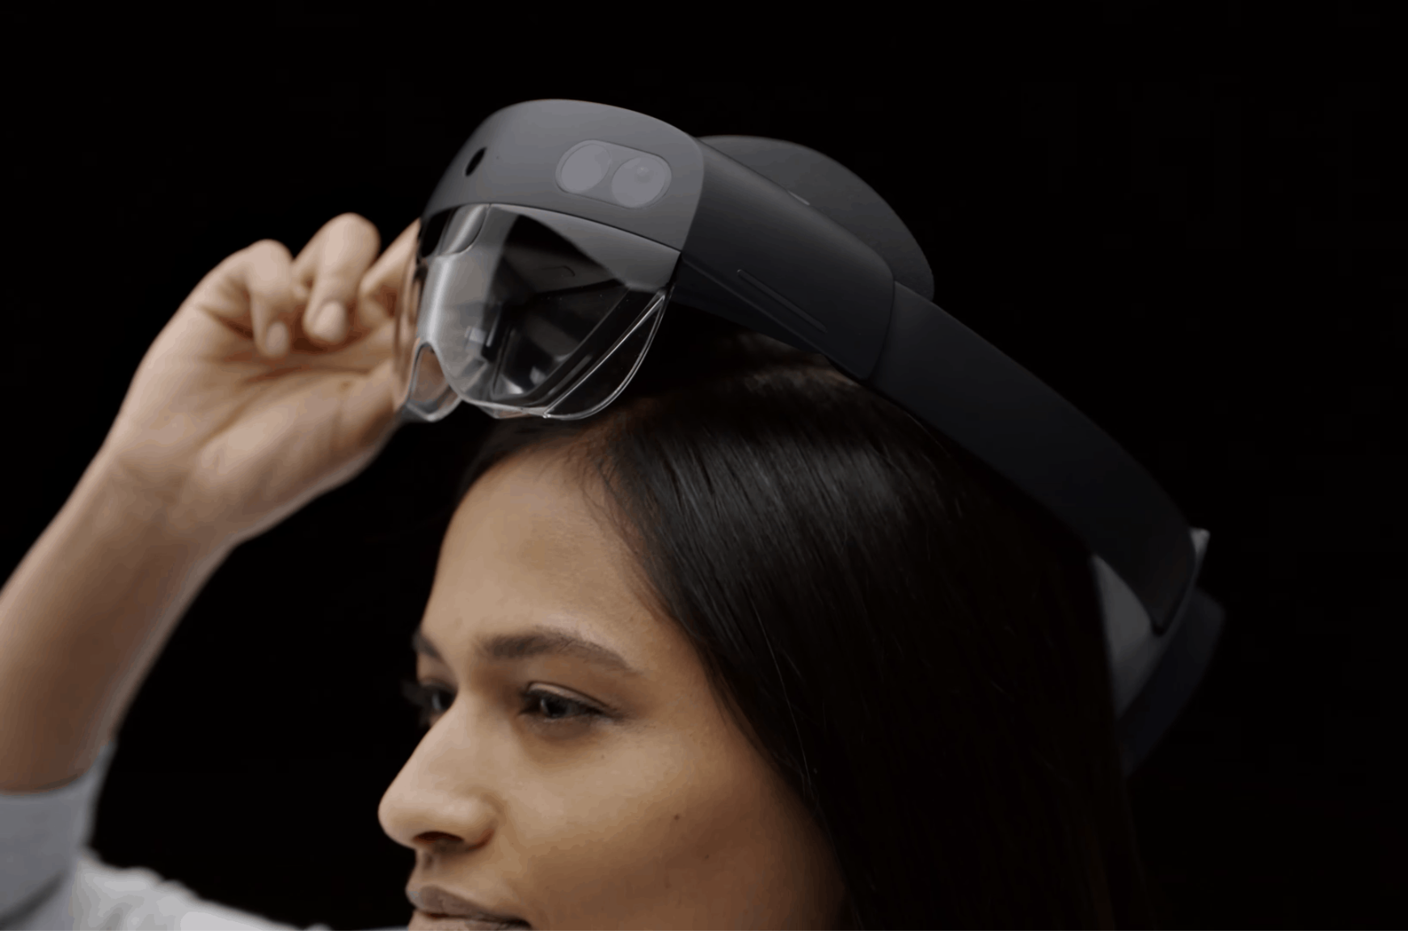
Current landscape
Apple – Vision Pro + visionOS, strong app ecosystem.
Meta – Quest 3 MR headset, Ray-Ban smart glasses.
Microsoft – HoloLens 2 for enterprise use.
Magic Leap – Pivoted to enterprise (ML2).
Snap – AR Spectacles for devs only.
Google – Paused AR glasses; focusing on software/tools.
Notes:
Apple’s Spatial Computing Ecosystem: Apple’s Vision Pro (shipping 2024) leads in hardware innovation with high-resolution passthrough AR, advanced eye-hand-voice controls, and a dedicated OS. Apple is launching a robust App Store with hundreds of thousands of existing iPad/iPhone apps adapted for ARapple.com. This integration of hardware, software (visionOS), and developer tools signals a strong push toward viable consumer AR.
Meta (Facebook): Meta is investing heavily in mixed reality and future AR glasses. The Meta Quest 3 (2023) VR/MR headset uses color passthrough cameras to enable “mixed reality” experiences, letting users see and interact with virtual objects in their real spacewashingtonpost.com. In parallel, Meta’s partnership with Ray-Ban has produced camera-equipped smart glasses (latest $299 Ray-Ban Meta Glasses) focused on photos, video and audio capturewashingtonpost.com. While these glasses don’t yet project AR visuals, Meta’s roadmap includes true AR eyewear in coming years, building on its experiments like Project Aria and its vast AR effects ecosystem on social platforms.
Microsoft: Microsoft’s HoloLens 2 remains a cornerstone of enterprise AR. It provides a fully self-contained headset running Windows Mixed Reality, widely used for hands-free remote assistance, 3D visualization, and training in industries (e.g. engineering and healthcare)next.reality.news. However, recent reports suggest Microsoft is recalibrating its AR strategy (the planned HoloLens 3 is uncertain), focusing on existing enterprise and military contracts while possibly exploring partnerships to sustain its AR hardware leadership.
Magic Leap: After a rocky start in the consumer space, Magic Leap pivoted to enterprise AR. The Magic Leap 2 (launched 2022 at ~$3,299) is a slimmer, lighter headset with a 70° field of view and improved opticstheverge.comtheverge.com. Magic Leap 2 is positioned for professional use – early programs include partnerships with medical and industrial companies – and it supports open platforms (like OpenXR) to integrate into enterprise workflows.
Google: Google’s current AR efforts emphasize software and platforms rather than immediate new hardware. In 2020, Google acquired North (a smart glasses startup) and teased prototype AR glasses with real-time translationtheverge.com. However, in 2023 Google reportedly canceled “Project Iris”, its internal AR glasses project, shifting focus to an Android-based “micro XR” platform for other manufacturers’ headsetstheverge.comtheverge.com. Google continues to advance mobile AR (ARCore on Android) and is partnering with Qualcomm and Samsung on a future mixed-reality ecosystemtheverge.com, keeping Google’s foot in the AR space via software.
Snap Inc.: Snapchat’s parent company remains an AR innovator on the software side (with thousands of AR Lens filters) and is iterating on AR eyewear. Snap’s latest Spectacles (5th-gen) are lightweight AR glasses with a 46° transparent display, offered only to developers for nowtheverge.com. Snap rents these AR Spectacles for $99/month to encourage creators to build new AR experiencestheverge.comtheverge.com. While not yet consumer-ready (battery life and brightness remain limiting), Spectacles serve as a testbed for social AR interactions and demonstrate Snap’s vision for eventually mainstream, fashion-friendly AR glasses.

Slide 4
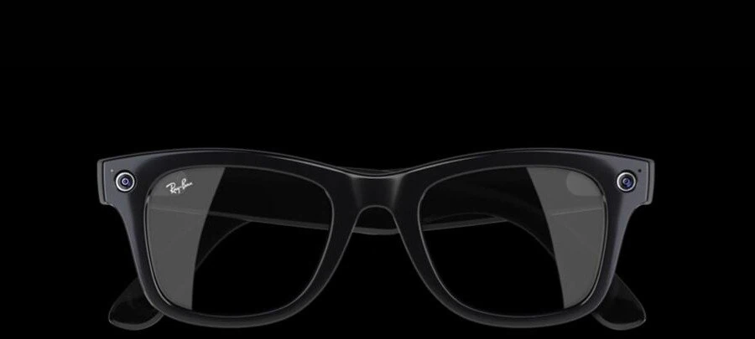
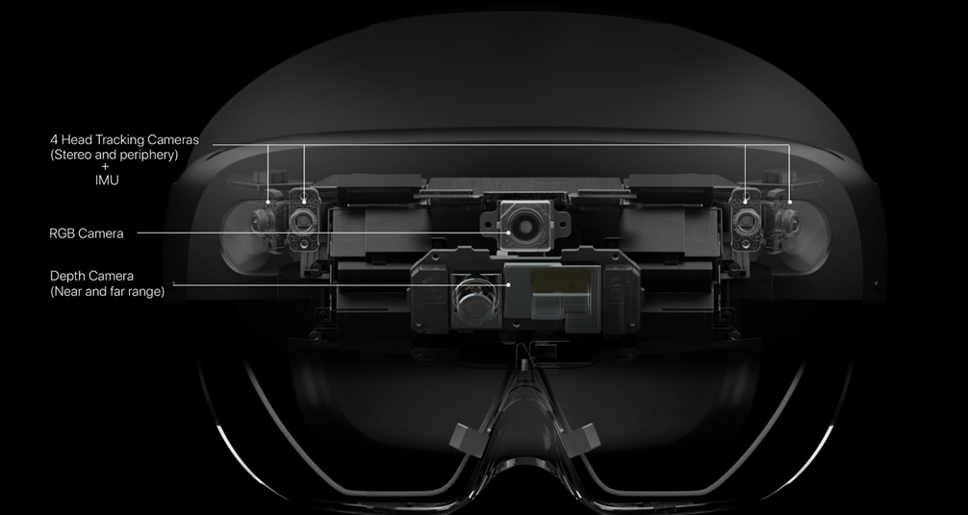
Upcoming progress
Lighter, glasses-style form factors
Improved battery + compute offloading
AR cloud = shared spatial context
Context-aware AI (scene, object, translation)
Eye/hand/voice interaction
App support via iOS/Android + WebXR
Notes:
Smaller, Lighter Form Factors: A key focus in the next 3–5 years is making AR glasses resemble normal eyewear. Companies are investing in microLED displays, waveguide optics, and compact batteries to reduce bulk. The future AR devices are expected to be “smaller, more stylish, and affordable,” shedding headset stigmaortmoragency.com. For example, Qualcomm’s reference designs and Meta’s research prototypes aim for sunglasses-like AR frames by mid-decade. Sleeker designs will improve comfort and social acceptability, which is crucial for everyday use.
Improved Battery Life & Processing: Current AR headsets often last only 2–3 hours on batteryen.wikipedia.org. Near-term solutions include offloading computation to companion devices (phones or compute pucks) and leveraging more efficient chips. The Apple Vision Pro uses a dedicated R1 co-processor for sensor fusion to minimize latency while optimizing power useen.wikipedia.org. We anticipate advances in battery tech and energy-efficient ARM-based processors, so AR glasses can run a full workday. Additionally, 5G and edge computing will play a role – high-bandwidth, low-latency connections allow graphics or AI processing to happen in the cloud, easing the hardware requirements on the glassesimaginovation.net.
Spatial Computing & AR Cloud: To make AR more useful, companies are building the “AR cloud” – a shared 3D map of the world that AR devices can tap into for context. This enables persistent digital overlays pinned to real locations and multi-user AR experiences. For instance, Niantic’s Lightship platform and Microsoft’s Azure Spatial Anchors allow developers to anchor content in physical space globally. In the near term, expect AR apps where, say, you leave virtual notes at a location or see Yelp reviews floating over a restaurant when you look at it. Shared contextual awareness will make AR far more practical for navigation, tourism, and social interaction.
Advanced AI Integration: Improved AI will make AR more context-aware and intuitive. Computer vision AI can recognize objects, faces, text, and environment semantics in real time, allowing AR glasses to provide relevant information automatically (e.g. identifying machine parts and pulling up manuals, or translating signs on the fly). Generative AI assistants might be built into AR to answer questions about what you’re seeing. Enhanced spatial “scene understanding” means AR can place virtual objects realistically (occlusion, lighting) and interact with the real world. In the next few years, AR design will leverage AI to filter and personalize content – showing you helpful data when needed, and hiding it when it’s not relevant, thereby tackling information overload.
Natural Interaction Methods: Near-term AR will refine how users interact with digital content in their environment. Hand-tracking, gesture control, eye-tracking, and voice commands are all active areas of development. Apple Vision Pro’s use of eye gaze for targeting and finger pinch for clicking has been praised for its intuitivenessapple.comapple.com. Similarly, HoloLens and Magic Leap use hand gestures and voice (“select”, “zoom”) to manipulate holograms. Future AR designs will combine inputs – e.g. gaze to select and voice to execute (“open that email”) – to minimize the need for controllers or phones. Haptic feedback is also being explored (wearables that simulate touch) to make AR interactions more tactile and convincing. Designers will need to ensure these interactions feel seamless and account for accessibility (e.g. alternatives for those who cannot speak or use certain gestures).
Robust App Ecosystems and Tooling: To be effective, AR needs compelling apps and content. In the near term, we’ll see convergence of AR and existing app ecosystems – for example, Apple allowing millions of iPad/iPhone apps to run in Vision Pro’s AR space (windowed as floating screens)apple.com. This bootstrap approach means users immediately have useful things to do in AR (like browsing web, watching videos, messaging) alongside dedicated AR experiences. On the developer side, AR creation is being democratized by tools like Unity, Unreal, WebAR frameworks, and no-code platforms. WebXR in browsers is maturing, so lightweight AR experiences can be accessed with a URL. As tools and libraries improve, designers can more easily prototype AR interfaces and companies can iterate on practical applications — accelerating the diversity and quality of AR use cases available within 5 years.

Slide 5
Applications

Slide 6

Workplace
Live language translation - AR captions help bridge language barriers in conversations.
Accessibility support - Auto-captioning and sound-to-text for mixed-ability interactions.
Note-taking & memory recall - Automatically transcribes meetings and retrieves past decisions or documents on command.
Task automation - AI assistant handles scheduling, follow-ups, and communication drafts.
Hands-free control - Operate work tools, interfaces, or machines via voice or gesture commands.
Contextual overlays – Displays project data, client profiles, or instructions during in-person work.

Slide 7

Healthcare
Surgical Assistance - AR is aiding surgeons by overlaying critical patient data and medical imaging into their field of view during operations.
Medical Training & Education - AR/MR is being used to teach anatomy, procedures, and clinical skills in more immersive ways.
Patient Rehabilitation - Augmented reality is being explored in physical therapy and rehabilitation to increase patient engagement.
Personal health tracking - AR wearables can help monitor blood sugar/pressure, fitness goals, and brain/heart conditions
Notes:
Surgical Assistance: AR is aiding surgeons by overlaying critical patient data and medical imaging into their field of view during operations. For example, surgeons at Imperial College London used Microsoft HoloLens to project a patient’s CT scan (bones, blood vessels) onto the actual patient in real-time, essentially giving “X-ray vision” to help pinpoint vessels during reconstructive surgeryimperial.ac.ukimperial.ac.uk. Such AR-guided surgery can improve precision and outcomes by helping surgeons see anatomical details without looking away to 2D monitors. Early trials report that AR headsets in the operating room are practical and beneficial for surgical teamsimperial.ac.ukimperial.ac.uk. Beyond visualization, AR can also enable remote collaboration – a specialist can see what the surgeon sees via AR and guide when needed, which has been tested in fields like neurosurgery and orthopedics.
Medical Training & Education: AR/MR is being used to teach anatomy, procedures, and clinical skills in more immersive ways. Case Western Reserve University, for instance, uses HoloLens with a HoloAnatomy app to let medical students interact with 3D cadavers and organ models holographically. Students reported that 15 minutes with a life-sized 3D anatomy hologram saved them hours of dissection study, and improved their understanding of spatial relationships in the bodycase.edu. AR can also simulate surgery or emergency scenarios for training without risk to patients. Moreover, instructors can join students “in AR” remotely – as a holographic avatar – to demonstrate techniques or guide traineescase.educase.edu, making medical education more accessible and interactive, especially in an era of remote learning.
Patient Rehabilitation: Augmented reality is being explored in physical therapy and rehabilitation to increase patient engagement. AR rehab apps can gamify exercises – for example, stroke patients wearing AR glasses might see virtual targets or rings that encourage them to move affected limbs correctly, turning therapy into an interactive game. Studies indicate that AR-based rehab can improve motor function recovery by providing real-time feedback and motivating patients more than traditional exercisespubmed.ncbi.nlm.nih.gov. In occupational therapy, AR glasses can overlay prompts to guide patients through daily tasks (like an AR coach), helping re-train cognitive and motor skills. Such use cases are nascent but growing as inexpensive AR-on-tablet and upcoming lightweight glasses make in-home rehab training feasible with clinician oversight.

Slide 8

Education
Immersive Learning Experiences - AR allows students to bring abstract concepts to life in the classroom.
Language Support and Translation - AR smart glasses are breaking language barriers in education.
Special Needs and Paced Learning - AR offers more flexibility to tailor coursework to individual students’ needs.
Remote and Collaborative Learning - With AR/MR, remote students can feel virtually present.
Notes:
Immersive Learning Experiences: AR allows students to bring abstract concepts to life in the classroom. Wearing AR glasses or using mobile AR, learners can, for instance, see a 3D solar system orbiting on their desk or explore a virtual ancient ruin on the school playground. This interactive visualization boosts engagement and understanding – complex STEM topics like geometry, physics, or biology become easier when students can manipulate 3D models overlaid on the real worldfsrinc.comfsrinc.com. Museums and field trips are also transformed through AR; a student pointing a device at a dinosaur skeleton might see a lifelike dino model appear over it. These experiences cater to visual and kinesthetic learning styles, making education more inclusive and exciting.
Language Support and Translation: AR smart glasses are breaking language barriers in education. A device like the Vuzix Blade can display real-time subtitles or translations for students who are deaf or learning a new languagecapsulesight.com. Imagine a newcomer student seeing the teacher’s speech transcribed in their native language via AR glasses – they can follow along more easily. Or language learners could wear AR glasses on a field trip, and as they look at objects or signs, the glasses label them in the language they’re studying (with pronunciation aids)fsrinc.comcapsulesight.com. This contextual learning accelerates vocabulary acquisition. AR translation tools are especially useful in bilingual classrooms and for making lessons accessible to hearing-impaired students through live captioning.
Remote and Collaborative Learning: With AR/MR, remote students can feel virtually present. Mixed-reality headsets (like HoloLens or future AR glasses) enable virtual classroom environments where remote learners see 3D avatars of classmates and teachers as if co-located. One example used HoloLens 2 for virtual lab sessions – students at home could walk around a life-size hologram of an engine or molecule and discuss it together. AR can also facilitate expert telepresence in classes: a guest lecturer might appear as a hologram in the middle of the room. Early trials show that such approaches make remote learners feel more engaged than a flat video callcapsulesight.com. Additionally, AR enhances classroom collaboration; for instance, students working on an AR puzzle or art piece can see each other’s changes in real time by looking through tablets/glasses, promoting interactive group problem-solving even if not everyone is physically there.

Slide 9
Design challenges
Natural input (gaze, gesture, voice)
Comfort & battery (heat, weight)
Avoid visual clutter & info overload
Privacy cues (recording indicators, local compute)
Inclusive UX (adjustable, voiceover, captions)
Social and regulatory acceptance
Notes:
Usability & Intuitive Interaction: Designing a user-friendly AR experience is challenging due to the lack of conventional inputs (mouse/keyboard). Controls must be “easy to use without being intrusive,” relying on natural actions like voice, gesture, and gazecapsulesight.com. Designers face the task of creating UIs that float in 3D space and are still intuitive – e.g. selecting a menu by looking at it and pinching fingers. There is a fine line between simplicity and capability; too few interface elements might limit functionality, but too many will confuse. User research is key: for instance, hand gestures need to be reliable and culturally appropriate, voice commands need clear feedback especially in noisy environments, and gaze-based selection must account for unintentional eye movements. In short, AR UX should minimize learning curve so that interacting with holograms feels as natural as using a smartphone touch screen.
Comfort, Ergonomics, and Wearability: Unlike phones, AR wearables are worn on the head/face, raising comfort to a top-tier concern. If a device is heavy, front-heavy, or poorly fitted, users will not wear it for long (or at all). “For smart glasses to gain widespread adoption, they must be comfortable for extended periods,” meaning lightweight materials, balanced design, and adjustable fits for different headscapsulesight.com. Current high-end headsets (600g+) can cause fatigue and pressure on the nose/forehead after 30+ minuteswashingtonpost.com. Designers are working to distribute weight (e.g. battery packs at the back of head or via a neckband) and use breathable, soft materials on touch points. Another aspect is visual comfort: AR displays must not strain the eyes – addressing issues like focal depth (vergence-accommodation conflict), brightness in various lighting, and text readability. Solving these will involve both hardware (optics that allow focusing at natural distances) and software (optimizing contrast, font sizes, etc.). Comfort also extends to social comfort – the device should not make the user or others around them uneasy. Achieving a slim, glasses-like aesthetic (no awkward protrusions or glaring lights) will help AR wearables blend in socially, which is part of ergonomic design in a broader sense.
Battery Life & Thermal Management: AR glasses pack many sensors (cameras, depth scanners), displays, and processors in a tiny frame, which consume power and generate heat. Limited battery life is a major UX drawback today – users having to recharge glasses every 2–3 hours interrupts seamless usecapsulesight.com. Frequent charging also raises user frustration and reduces willingness to rely on the device. Designers and engineers must collaborate on power-saving strategies: for example, using eye tracking to only render full detail where the user is looking (foveated rendering) to save processing power, or employing ambient light sensors to dim displays when not needed. Some AR systems use an external battery pack (Apple Vision Pro’s battery on a cable) to shift weight off the headset and allow swapping batteries. Thermal comfort is related: heat near the face can be uncomfortable or even unsafe. Ventilation, low-power chip designs, and smart power management (e.g. sleeping modules when not in use) are crucial to prevent the glasses from getting warm on the user’s skin. Ultimately, breakthroughs in battery energy density or wireless power could alleviate these issues, but in the near term it’s a balancing act between capability and endurance.
Information Overload & Distraction: Presenting digital overlays in one’s view raises the risk of overwhelming the user or distracting them from real-world tasks. A core UX principle for AR is to keep the virtual information relevant, timely, and minimal for the context. If a user is flooded with notifications, virtual ads, or dense data readouts while walking or driving, the consequences could be dangerous. Good AR design practices include context-aware filtering (e.g. no non-critical notifications while the user is moving at high speed or doing a critical task), and using subtle cues instead of persistent large graphics. For instance, navigation arrows might appear only near an upcoming turn instead of constantly in view. Studies have shown that reducing the need to “context-switch” improves task performance – Boeing’s AR instructions succeeded in part by lowering cognitive load compared to flipping through manualsarinsider.co. Designers should utilize spatial audio and haptic cues as well, to offload some information from visual channels. Moreover, giving users easy control to turn off or snooze AR content is key for preventing overload; a quick gesture or physical button to clear the view can help users reset when they feel inundated. Ultimately, thoughtful UX will ensure AR serves the user instead of incessantly demanding attention.
Privacy and Social Acceptance: AR glasses, especially those with outward-facing cameras and always-on data streams, raise significant privacy concerns. Bystanders may feel uncomfortable not knowing if they are being recorded or analyzed by someone’s glasses (a lesson from Google Glass’s “Glasshole” backlash)ortmoragency.com. Designers and policymakers must work together on privacy-respecting cues and norms. Some design solutions include visible indicator lights when recording or using certain sensors, and quick physical shutters to cover cameras when not needed. On the software side, implementing on-device processing (so raw camera data isn’t constantly uploaded) and transparent data policies will build trust. From a user’s perspective, AR devices also create personal privacy considerations: they will collect a lot of sensor data about what the user looks at, where they go, and even biometric info (iris scan for eye tracking, etc.). Robust security and opt-in permissions are necessary to protect this sensitive datacapsulesight.com. User-centered design means giving wearers control – for example, the ability to easily mute microphones and disable cameras, or an LED that assures them when sensors are active. Finally, social acceptance might involve etiquette guidelines (like “no AR glasses in locker rooms or cinemas”) similar to smartphone norms. Over time, as devices become commonplace and visibly less intrusive, society may become more comfortable, but proactively addressing privacy fears is essential for designers today.
Accessibility & Inclusive Design: AR’s potential will only be fully realized if the technology is accessible to people of differing abilities. This means designers should build in features like adjustable text size and contrast for low-vision users, compatibility with hearing aids or cochlear implants for audio output, and alternative input methods for those who cannot use hand gestures (perhaps brain-computer interfaces or EMG armbands as emerging tech)capsulesight.com. There are positive signs: Apple’s visionOS is reimagining VoiceOver (screen reader) for a spatial context, so a blind user could have the AR system narrate objects and menus around themapple.com. Another consideration is comfort adaptations – accommodating users who wear prescription glasses (many AR headsets offer spacer inserts or prescription lens attachmentsapple.com) and designing for different interpupillary distances, face shapes, and skin tones (for facial-tracking to work accurately on all). Inclusive design also extends to content: ensuring AR experiences do not rely solely on color (for color-blind users), providing captions for AR audio, and giving users choices in how information is presented (visual vs auditory). As AR is still in its formative stage, there’s a real opportunity to bake in accessibility from the start, which not only benefits users with disabilities but often improves the overall user experience for everyone. By involving diverse users in testing – e.g. people with low vision testing AR navigation, autistic users testing social cue apps – designers can identify barriers and refine solutions early, steering AR toward being a universally empowering technology.

Slide 10
Questions
What will be the biggest barriers to make AR available, accessible, and accepted?
Which areas do you think will be the first to adopt AR and benefit from it?
How would you personally like to use AR?
How will AR shift the role of designers and product people going forward?

Slide 11
Thank you!

